Slide 1





IIIT DHARWAD
OS and Cloud
Computing Project
Presented by 21BDS005
21BDS020
21BDS021
21BDS0016

Slide 2




HADOOP
Distributed Computing Framework: Hadoop is a distributed computing framework that enables the processing of large datasets across clusters of commodity hardware.
Hadoop Distributed File System (HDFS): HDFS is the primary storage system used by Hadoop, designed to provide scalable and fault-tolerant storage for large data sets.
MapReduce Programming Model: Hadoop uses the MapReduce programming model for processing data across the Hadoop cluster, enabling parallel processing of data.
Open Source: Hadoop is an open-source software framework, meaning that it is free to use and can be modified and customized to suit specific needs.
Big Data Analytics: Hadoop is commonly used for big data analytics, such as processing large volumes of data to extract insights and support decision-making.

Slide 3



STEP 3
Download and Extract Hadoop: Download the Hadoop distribution that you have chosen and extract it to a directory of your choice.
HADOOP INSTALLATION
STEP 4
Configure Hadoop: Update the configuration files to reflect the settings for your Hadoop installation, such as the number of nodes, cluster settings, and security settings.
STEP 5
Start Hadoop Services: Start the Hadoop services, such as the NameNode, DataNode, and ResourceManager, by running the appropriate commands.
STEP 6
Verify the Installation: Verify that Hadoop is running correctly by running a simple Hadoop job or by accessing the Hadoop web interface.
STEP 1
Choose a Hadoop distribution: There are several Hadoop distributions available, such as Apache Hadoop, Cloudera, Hortonworks, and MapR. Select the distribution that meets your needs.
STEP 2
Install Java: Hadoop requires Java to run. Install a compatible version of Java on your system.

Slide 4
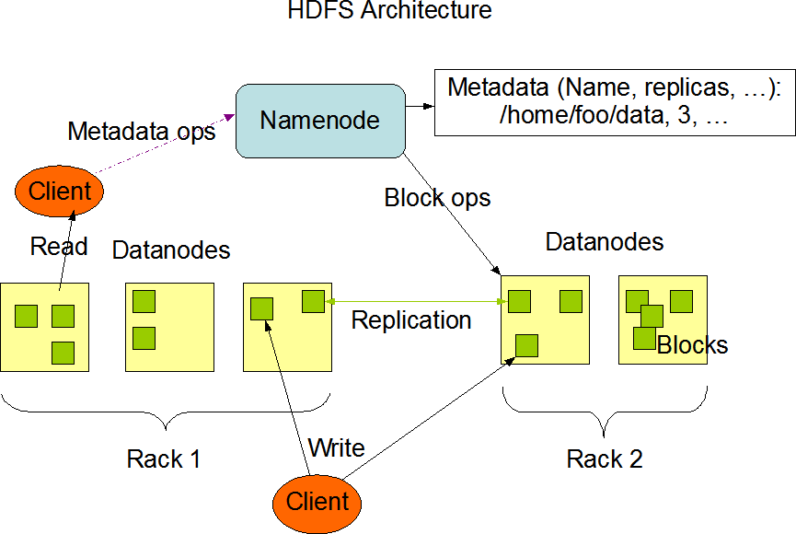
HDFS
HDFS is a distributed file system used by Hadoop to store and manage large datasets.
It uses a master-slave architecture with NameNode as master and DataNodes as slaves.
HDFS provides features like data replication, integrity, and high availability.
It is optimized for batch processing and not for real-time processing or low-latency access.
HDFS can be accessed using interfaces like CLI, API, and web interface.

Slide 5
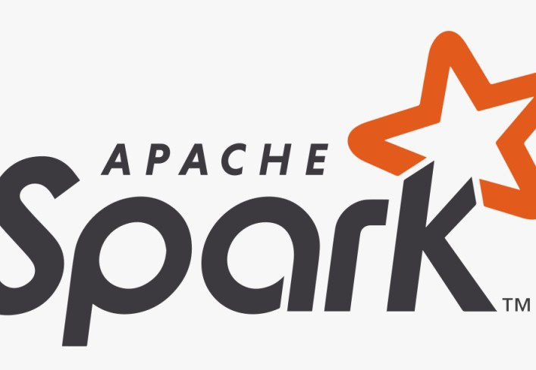
APACHE SPARK
Apache Spark is a distributed computing system designed for processing large volumes of data in a fast and efficient manner.
Spark provides a powerful processing engine that can optimize data processing and computation across the entire cluster, including support for in-memory processing, caching, and lazy evaluation.
Spark includes a set of high-level APIs for working with structured and semi-structured data, including SQL, DataFrames, and Datasets.
Spark provides a wide range of libraries and tools for working with different types of data, including text, graph, and machine learning data.
Spark is designed to be highly scalable and fault-tolerant, and it can handle large volumes of data with ease, even in the face of hardware failures or other types of disruptions.
Spark can run on a variety of deployment models, including standalone mode, Hadoop YARN, and Apache Mesos, and it can be integrated with other big data tools and technologies, including Hadoop, Cassandra, and Kafka.

Slide 6


SPARK INSTALLATION
STEP 3
Extract Spark: Extract the Spark archive to a directory where you want to install Spark.
STEP 4
Configure Environment Variables: Set the SPARK_HOME environment variable to the directory where Spark is installed, and add Spark's bin directory to your PATH.
STEP 1
Download Apache Spark: Visit the official Spark download page and download the pre-built version that matches your Hadoop distribution and Scala version.
STEP 5
Start Spark: Start Spark by running the spark- shell command in a terminal window, which opens up a Scala REPL.
STEP 2
Install Java: Install the latest version of Java on your system, as Spark requires Java 8 or later to run.

Slide 7

AN OVERVIEW OF HOW SPARK ALGORITHMS CAN BE EXECUTED ON AN HDFS CLUSTER:
The Spark job is submitted to the Spark cluster manager, which is responsible for managing the cluster resources and scheduling tasks.
The Spark driver program creates a SparkContext, which serves as the entry point for the Spark application. The SparkContext is responsible for coordinating the execution of the Spark tasks across the cluster.
The Spark tasks are executed on the worker nodes of the HDFS cluster. Each worker node runs a Spark executor process, which is responsible for running the tasks assigned to it by the Spark driver.
The input data for the Spark job is stored in HDFS, which is a distributed file system that is optimized for storing large files. The Spark tasks read the input data from HDFS and process it using the Spark algorithms.
The output data from the Spark job is also stored in HDFS, either as a single output file or as multiple output files. The output data can then be processed by other Hadoop tools or accessed by other applications.

Slide 8
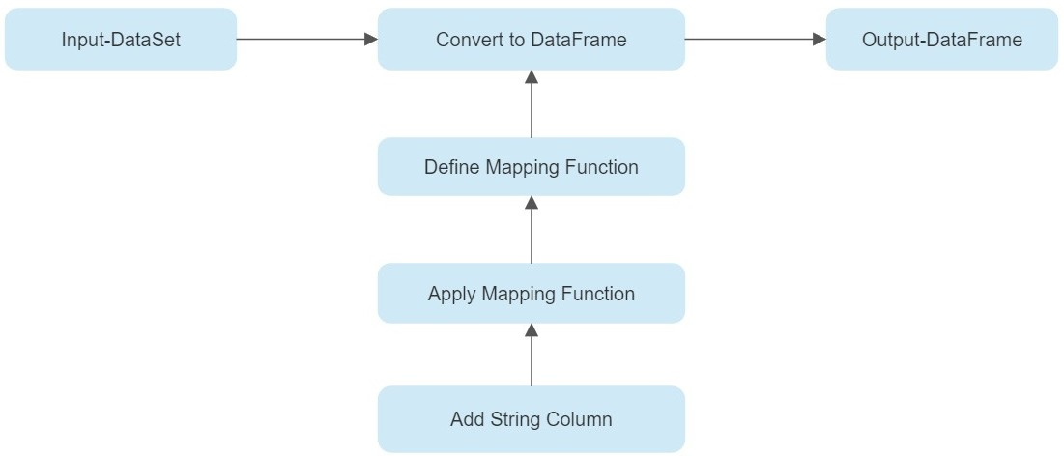

INDEX TO STRING ALGORITHM
The Index to String algorithm is a common technique used in natural language processing and machine learning applications.
It involves converting numerical indices to their corresponding string or categorical values.
The algorithm is used to transform the output of machine learning models from numerical indices to human-readable text.
This can improve the interpretability and explainability of machine learning models, making them more trustworthy and easier to understand.
The Index to String algorithm is supported by popular machine learning frameworks like TensorFlow, PyTorch, and Apache Spark.

Slide 9
BENEFIT OF HDFS CLUSTER FOR INDEX TO STRING ALGORITHM
Distributed Storage:
HDFS is designed to store and manage large datasets across a distributed network of commodity hardware. This allows the algorithm to process large volumes of data without the need for expensive hardware.
Fault Tolerance:
HDFS provides fault tolerance by replicating data across multiple nodes in the cluster. If a node fails, the data can still be accessed from other nodes, ensuring that the algorithm can continue running without interruption
Cost-effective:
HDFS is an open-source framework that runs on commodity hardware, making it a cost-effective solution for storing and processing large datasets. This allows organizations to process large volumes of data without the need for expensive hardware or software licenses.
Data Locality:
HDFS stores data in a way that optimizes data locality. This means that when processing data using the Index to String algorithm, the data is processed on the same node where it is stored. This reduces network traffic and improves overall performance.
Scalability:
HDFS is designed to be highly scalable, allowing for easy scaling by adding or removing nodes from the cluster as necessary. This allows the algorithm to handle larger datasets as needed

Slide 10
HOW HDFS ENABLES DISTRIBUTED COMPUTING FOR THE INDEX TO STRING ALGORITHM
HDFS is designed to store and manage large datasets by distributing the data across a cluster of machines.
HDFS uses a master-slave architecture, with a single NameNode that manages the file system namespace and multiple DataNodes that store the data blocks.
When running the Index to String algorithm on a Hadoop cluster, the input data can be stored in HDFS and split into smaller blocks that can be processed in parallel by multiple nodes in the cluster.
The Index to String algorithm can be implemented using Hadoop MapReduce, which is a distributed processing framework that can efficiently process the data in HDFS.
Hadoop MapReduce divides the input data into smaller chunks and distributes the processing across multiple nodes in the cluster, allowing for parallel and distributed processing of the data.
By leveraging the distributed computing capabilities of HDFS and Hadoop MapReduce, the Index to String algorithm can process large datasets efficiently and in a scalable manner.

Slide 11


STEP 3
THE INDEX TO STRING ALGORITHM IN SPARK CAN BE EXECUTED ON A HADOOP DISTRIBUTED FILE SYSTEM (HDFS) CLUSTER BY FOLLOWING THESE STEPS:
Write the Spark code for the algorithm: The Index to String algorithm can be implemented using the Spark API in any language that supports Spark, such as Scala or Python. The code needs to read the data from HDFS, process it using the algorithm, and write the output back to HDFS.
STEP 4
Submit the Spark job to the cluster: Once the code is
written, it needs to be packaged into a JAR file and submitted to the Spark cluster using the spark-submit command. This command tells Spark to allocate the necessary resources and execute the job on the HDFS cluster
STEP 5
Monitor the job: During the execution of the Index to String algorithm, it is important to monitor the progress of the job to ensure that it is running correctly and to detect any issues that may arise. This can be done using the Spark web UI or any other monitoring tool that is compatible with Spark.
STEP 6
Retrieve the output: Once the job is complete, the output can be retrieved from HDFS using Hadoop commands or any other HDFS-compatible tool. The output will be in the form of a string that corresponds to the original index value
STEP 1
Install and configure Spark on the HDFS cluster: This step involves installing Spark on all the nodes of the HDFS cluster and configuring it to work with HDFS.
STEP 2
Load the data into HDFS: The data to be processed by the Index to String algorithm needs to be loaded into the HDFS cluster. This can be done using Hadoop commands or any other HDFS-compatible tool

Slide 12


BENEFITS OF THE INDEX TO STRING ALGORITHM
Enhanced Readability:
Converts numerical indexes to string representations, making the data more readable and interpretable for humans.
Improved Communication:
The algorithm makes it easier to communicate and share the data with others, especially non-technical stakeholders.
Increased Accuracy:
By converting numerical labels to their string representations, the algorithm can reduce errors that may occur due to confusion or incorrect mapping of numerical labels.
Simplified Analysis:
The algorithm simplifies the data analysis process by reducing the need for manual mapping of numerical labels to their corresponding string representations.
Versatility:
The Index to String algorithm can be applied to various data processing applications, including natural language processing and machine learning

Slide 13


INDEX TO STRING ALGORITHM ON LETTER FREQUENCY DATASET
StringIndexerModel indexer = new StringIndexer()
.setInputCol("category")
.setOutputCol("categoryIndex")
.fit(df);
Dataset<Row> indexed = indexer.transform(df);
public class JavaIndexToStringExample { public static void main(String[] args) { SparkSession spark = SparkSession
.builder()
.appName("JavaIndexToStringExample")
.getOrCreate();
// $example on$
List<Row> data = Arrays.asList( RowFactory.create(0, "a"), RowFactory.create(1, "b"), RowFactory.create(2, "c"), RowFactory.create(3, "a"), RowFactory.create(4, "a"), RowFactory.create(5, "c")
);
StructType schema = new StructType(new StructField[]{
new StructField("id", DataTypes.IntegerType, false, Metadata.empty()), new StructField("category", DataTypes.StringType, false,
Metadata.empty())
});
Dataset<Row> df = spark.createDataFrame(data, schema);
System.out.println("Transformed string column '" + indexer.getInputCol()
+ "' " +
"to indexed column '" + indexer.getOutputCol() + "'"); indexed.show();
StructField inputColSchema = indexed.schema().apply(indexer.getOutputCol());
System.out.println("StringIndexer will store labels in output column metadata: " +
Attribute.fromStructField(inputColSchema).toString() + "\n");
IndexToString converter = new IndexToString()
.setInputCol("categoryIndex")
.setOutputCol("originalCategory");
Dataset<Row> converted = converter.transform(indexed);
System.out.println("Transformed indexed column '" + converter.getInputCol() + "' back to " +
"original string column '" + converter.getOutputCol() + "' using labels in metadata");
converted.select("id", "categoryIndex", "originalCategory").show();
// $example off$ spark.stop();
}
}

Slide 14
DATASET

Slide 15

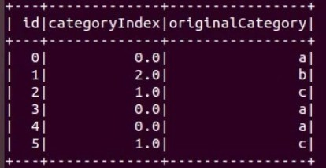

OUTPUT
The output of the Index to String algorithm is a new DataFrame or RDD with the same structure as the input data, but with the indexed columns replaced by their corresponding string values.

